Slide 1
REPORT OF INT 213
TOPIC : SUDOKU GAME
SUBMITTED BY : LAKSHIKA UPADHYAY 11910359
ARPIT DWIVEDI 11910402
VIKRAM MAHAJAN -11905434

Slide 2
INTRODUCTION
Sudoku is the Japanese abbreviation of a phase meaning the digits must remain single also known as Number Place, where su means number, doku which translates as single or bachelor. Sudoku is not a mathematical or airithmetical puzzle. It works just as well if the numbers are substituted with letters or some other symbols but numbers works best. The aim of the puzzle is to enter a numerical digit from 1 through 9 in each cell of a 9*9 grid made up of 3*3 subsquares or subgrids, starting with various digits given in some cells; each now, column and subsquares region must contain each of the numbers 1 to 9 exactly once.

Slide 3
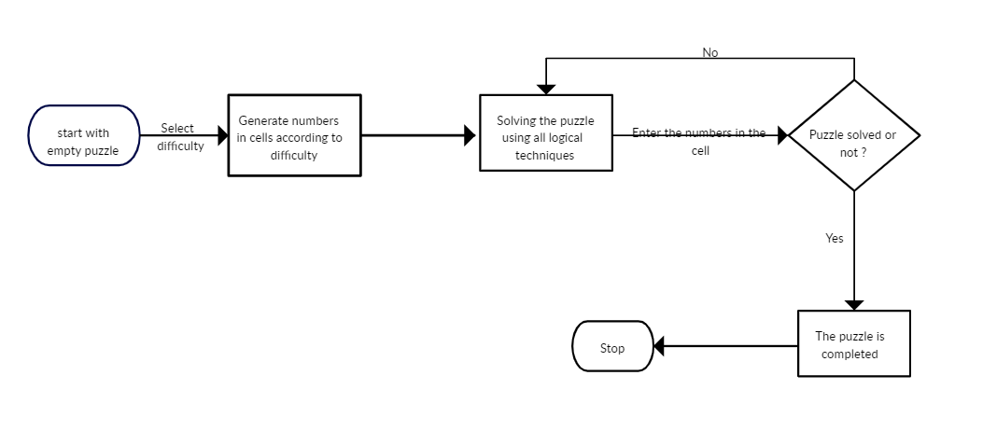
DFD FOR SUDOKU

Slide 4
METHODOLOGY
Requirement for User: The basic requirement was to create a simple Sudoku game, where user can able to get different puzzles, able to check and get solution for those puzzles, able to get solution for their own puzzles. Considering this requirement a simple 9x9 grid layout has been made and discussed with the users to find out what exactly they expect the user interface to be. Some of the questions which are raised during the discussion are.
I. Layout
II. Interaction either from mouse or keyboard
III. Type of menus
IV. Resizable window or not
V. Kind of help/support

Slide 5
Features Implemented
Game Interface to Play
Auto solving
Visualization of auto solving i.e., Backtracking Algorithm visualization
Options: Reset, Clear game

Slide 6
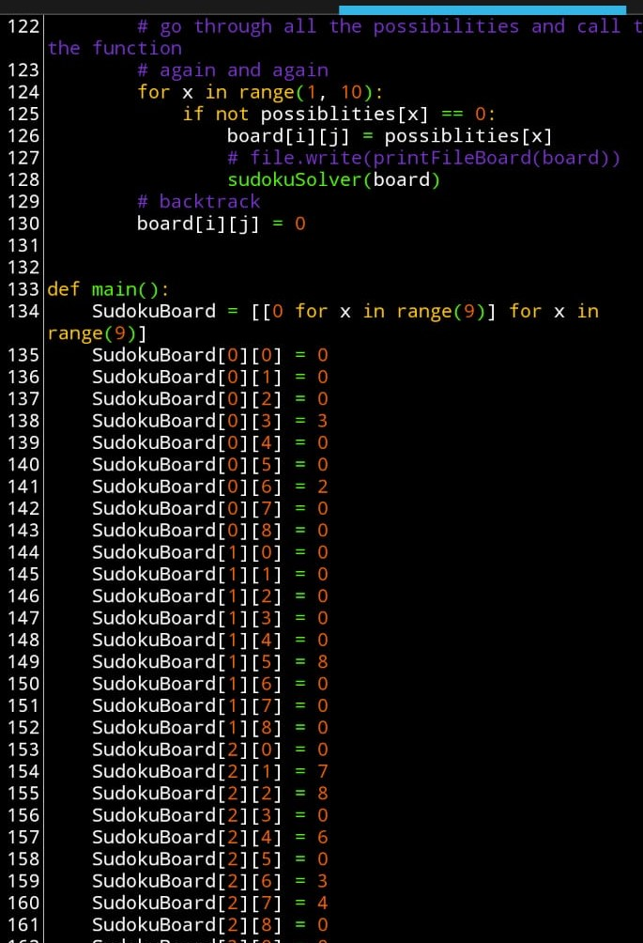
SCREENSHOT OF PROGRAM

Slide 7
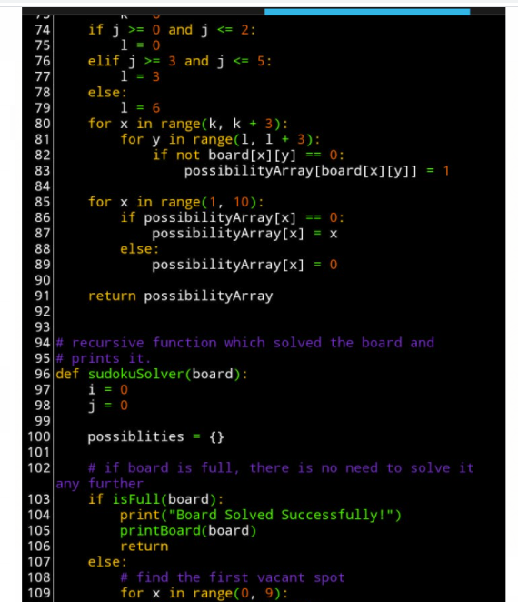

Slide 8
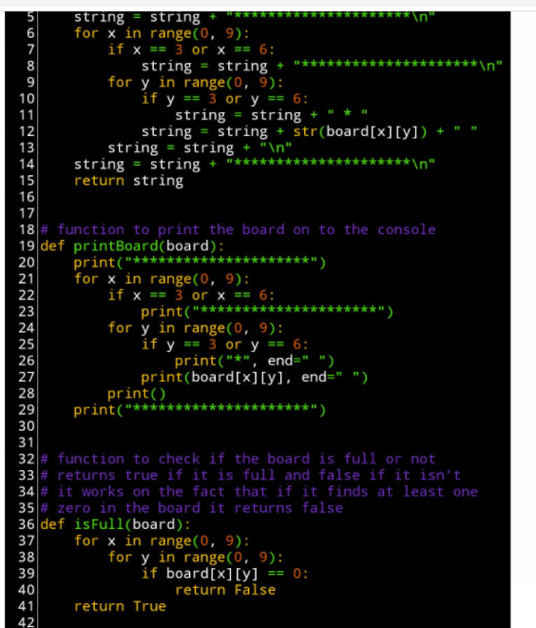

Slide 9
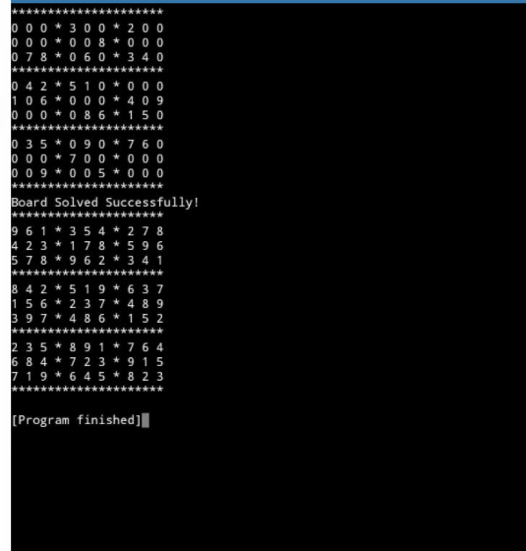
OUTPUT OF THE PROGRAM

Slide 10
CONCLUSION
Through generating this Sudoku solver and generator we feel we have improved our programming ability. This was perhaps the largest program in terms of time invested and lines of code written that I have created. The c ode is not of the highest quality, and it is severely lacking in documentation, but some of the problems posed by the project were a good challenge to solve. Writing the solver has demonstrated the advantages of ‘s mart’ algorithms over naïve algorithms evidenced in the measurements above. Finally, I have experienced participating in what could be called a small research project (useful for future work).

